Slide 1


Presented by :
Bianca Kubayi
Student enquiry management use case analysis

Slide 2



01
Introduction
02
Problem Statement
03
Current state analysis
Today’s Agenda
04
Business requirement definition
05
Improvement opportunity
06
Engagement plan
07
Summary
08
Q & A

Slide 3


Introduction
Northbridge University is faced with the operational challenge of managing student enquiries efficiently and students are struggling to receive assistance and obtain information from the university.
An analysis of the problem is required, as well as a solution that will help stakeholders and provide efficiency and value to the University

Slide 4

Problem Statement
Northbridge university is faced with a high volume of student enquiries through multiple channels, which are handled independently by the different departments in the university without a centralized system/process to capture, track and manage them. This has resulted in high response times, a lack of visibility on student enquiries, operational pressure and inefficiency, and overall student dissatisfaction.

Slide 5


Identified Issues And Possible Root Causes:
Difficulty tracking/managing enquiries received
Forwarded enquiries and inconsistent enquiry responses ( a run around for students)
Independent methods across departments to manage enquiries
Long response time to student enquiries
Difficulty prioritizing enquiries received
Operational pressure during peak periods
Lack of visibility on enquiry volume/bottleneck/progress
Multiple channels for student enquiries
Lack of standard processes/policies
No centralized process/system

Slide 6
Current state
At Northbridge University, students who need help with admin/registration/tuition etc., will contact the student services office either through email, calling, going in-person to enquire.
This enquiry will be directed by the student services offices to the department they find to be relevant to assist with the enquiry. The enquiry my be forwarded between department should it not be relevant to that department. The department will proceed to acknowledge the enquiry respectively (a spreadsheet, manually on paper etc.). Once the enquiry is fulfilled and the student has received feedback (probably through email) , the enquiry has been processed (maybe greened off on the spreadsheet). The student if assisted will proceed accordingly, otherwise they will enquire again.

Slide 7


Key Stakeholders
The Students
The University Leadership Team
The Student Services Office
The Academic Department
The Finance Department
The Admission Department
The IT Department
Other stakeholders:
Parents/Guardians

Slide 8

Business requirements
There is a single channel/portal for enquiries
There is real-time visibility of the enquiry placed (acknowledged, assigned, resolved)
Self-help for common enquiries (FAQs , website)
Timely and accurate responses
The centralization of system information to better manage the university information (kept updated)
The system enables enquiry KPIs that help monitor and manage response time, response accuracy (is it helping), enquiry volume, visibility of bottlenecks and problem points affecting student satisfaction
The single channel directs workflow to departmental workbaskets
System categorization (departments, topics) o enable accurate enquiry routing and prioritizing
Automated enquiry processes (no more forwarding and manual enquiry tracking)
The centralized system has t be integrated with existing systems and the technological infrastructure. (made available in the student portal)
Scalable for larger volume enquiries during peak periods
The solution has to align with existing IT regulations, storage, security, etc.

Slide 9
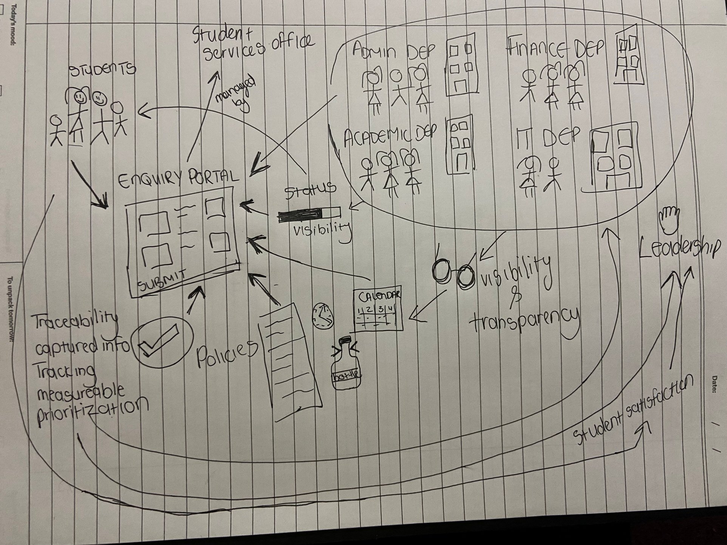
Improvement opportunity
Rich picture
A centralized student enquiry management system that provides students with a portal to submit enquiries and provides the university with a structured way of managing student enquiries.
The student selects the category for their enquiry, and the system adds the enquiry ticket the respective workbasket of that department. Should the information required by the student already exist elsewhere, the student will be redirected accordingly (FAQ/University website). The system enables monitoring of tickets or open queries running a long time or regarding registration during peak periods to place importance on them. The enquiry can be tracked on the system by the student (acknowledged, resolved etc.) The multiple channels are reduced to one. The information provided is centralized and becomes one source of truth. The work flow of managing student enquiries is standardized and more manageable for the different departments. Students will be better assisted and speedily so.

Slide 10
The Benefits:
AS-IS | TO-BE | BENEFIT
There are multiple channels with high enquiry volume (redundant enquiries possible) There are different methods across departments for handling enquiries It takes a long time to get a response Enquiries are forwarded and may cause multiple inconsistent responses The university leadership doesn’t have a way of enforcing or improving student satisfaction and making sure they are helped. Student have to follow up, they can’t see the progress on their enquiries There is an inability to track or prioritize enquiries received There is operational pressure during peak periods | There is one channel (the student enquiry management system) Common enquiries are quickly directed (FAQ/ the university website) with existing information readily available Ticketing system standard across all departments whereby the enquiry is assigned to each department and prioritized with urgency based on the enquiry or the peak period (registration, student fee deadlines etc.) Standards applied through new policies regulating the system (e.g. Average time for an enquiry to be responded to, how ‘uncategorized’ enquiries are directed, responsibilities of the system, technical specifications etc.) There is transparency of enquiries, response times, volume across all departments for leadership and the departments to have oversight. There wont be any lost or forgotten enquiries. | Accuracy – one source of information/single knowledge base, no more inconsistent replied, no having to contact multiple departments Efficiency – faster responses because of immediate redirection of common enquiries and direct department workbaskets, prioritization logic based on urgency, response time KPI enforced. Reliability - Reduced manual work, becomes system driven There is more transparency and visibility for the student on their enquiry (the system indicates and notifies the student when their ticket is submitted, received by the department, and resolved). The departments can capture, track and manage enquiries Reduced operational pressure Student experience improvement – less follow ups, faster response, accurate information

Slide 11

Our engagement plan:
Approach
Stakeholder engagement
Delivery plan
Current state and problem analysis
Root cause analysis
Research (student, staff, systems in place, IT)
Data analysis
Stakeholder engagement
Solution design
Meetings
Interviews
Surveys
A hybrid agile methodology for the delivery of the centralized student enquiry system
( a structured plan with iterative phases)

Slide 12
The timeline:
6-10 weeks
1-5 weeks
4-7 weeks
2-4 weeks
Current state (As-is) analysis and requirements gathering
Solution analysis (To-be) and solution design
Development.
Testing and deployment
Stakeholder engagement
Research
Solution development and configuration
Date pipeline development
System integration
Stakeholder engagement
User acceptance testing
System documents (how to use it, how it works)
Communication
Deployment
Sign-off and monitoring
Stakeholder engagement
Research
RCA
Requirements elicitation
Stakeholder engagement
Research
Wireframes
Documentation and design
Data gathering

Slide 13
In summary
Northbridge University is able to overcome the operational challenges faced regarding student enquiry management by leveraging a technological solution that improves operational efficiency, student experience and visibility.

Slide 14
Presented by :
Bianca Kubayi
Thank You
Any questions?

